Slide 1

Tree and Ensemble Methods. SVMs
Machine learning algorithms using tricks
Yordan Darakchiev
Technical Trainer
yordan@softuni.bg

Slide 2
Sli.do
#softuni-trees

Slide 3
Table of Contents
Decision trees
Ensemble algorithms
Random decision forests
AdaBoost
Support vector machines (SVMs)
k-nearest neighbors

Slide 4
Decision Trees
"To be or not to be…"

Slide 5
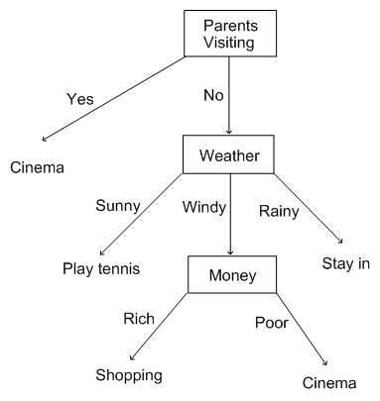
Decision Trees
Can be used for classification or regression
Root: top node (always a single root)
Leaves: bottom nodes
Getting an answer: path from root to a leaf
Best feature: easy to interpret
Answer a series of yes / no questions to get the data model
Similar to the way we decide what to do
We can construct our own decision trees using if-statements
Machine learning problem -> construct the tree without involving "brain power"

Slide 6
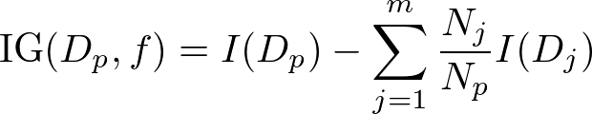


Decision Trees (2)
We need to start at the root and split the data on the feature that results in the largest information gain (IG)
Then iterate until every leaf node contains only one class
This may lead to overfitting (too deep tree, too many nodes)
Pruning – limiting the max depth
Objective function: maximize IG:
– feature to perform the split on
– datasets of the parent and child nodes
– number of samples (at parent / child nodes)
– impurity measure
More simply, difference between parent and child impurities
Greater difference = more IG

Slide 7
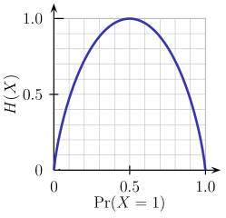
Impurity Measures
Most libraries implement binary decision trees
Each node can have 0, 1 or 2 children
Reasons: simplicity, reducing the search space
Three common impurity measures
Entropy – measure of classification uncertainty
Probability 0 or 1 = no uncertainty
Probability 0.5 = max uncertainty
Gini index – similar to entropy
Criterion to minimize the probability of misclassification
We usually use one of the measures, as they provide similar results
Misclassification error – linear measure (0 at p = {0, 1}, max at p = 0.5)
Good for pruning a tree but worst measure for growing

Slide 8
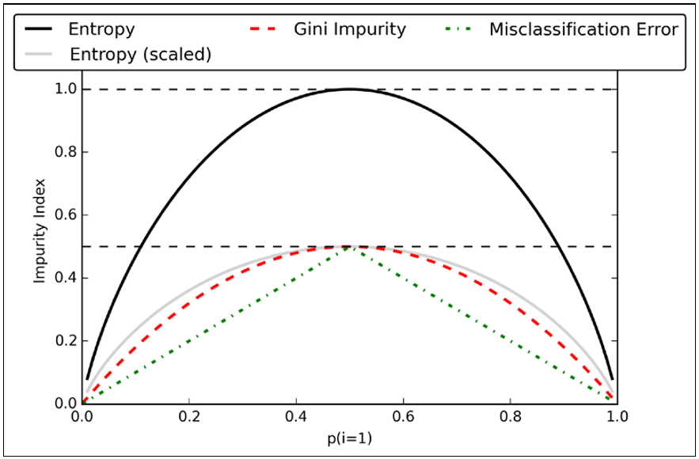
Lab: Visualizing Impurity Measures
For a two-class {0, 1} classifier, visualize the impurity measures
Parameter p – probability of class 1 => measure
Scaled entropy: entropy / number of classes
Observations
Min: p = {0, 1}, max: p = 0.5
Entropy and Gini are very similar
def entropy(p):
return – p * np.log2(p) - (1 - p) * np.log2((1 - p))
def gini_index(p):
return (p) * (1 - (p)) + (1 - p) * (1 - (1 - p))
def misclassification_error(p):
return 1 - np.max([p, 1 - p])

Slide 9
Decision Trees in scikit-learn
Creating and fitting a classifier – as usual
Parameters
criterion: "gini" (default), "entropy"
max_depth
max_features (usually we don't change this)
Outputs
feature_importances_ – Gini scores for all features
n_classes_, n_features_
from sklearn.tree import DecisionTreeClassifier
decision_tree = DecisionTreeClassifier()
decision_tree.fit(attributes, labels)

Slide 10
Lab: Decision Trees
Create and visualize a decision tree for the income dataset
Use entropy as the measure and a max depth of 4
Display a 10-fold cross-validation score (use the default scoring mechanism – accuracy)
Display the generated tree
Install graphviz first (if you have trouble installing, ask StackOverflow)
Export a tree description
Convert to PDF
conda install graphviz
from sklearn.tree import export_graphviz
with open("adult.dot", 'w') as f:
f = export_graphviz(decision_tree, out_file = f)
dot -Tpdf adult.dot -o adult.pdf

Slide 11
Lab: Visualizing Decision Tree Boundaries
For simplicity, let's use the Iris dataset
This method can be applied to all classifiers, not only trees
Select 2 features (for a 2D plot)
Predict class values for a "mesh" of evenly-spaced samples
Plot the test data and predicted values in different colors (classes)
from sklearn.datasets import load_iris()
iris = load_iris()
from sklearn.datasets import load_iris()
X = iris.data[:, :2] # Sepal length, sepal width
y = iris.target
step_size = 0.02
color_dict = {0: "blue", 1: "lightgreen", 2: "red"}
colors = [color_dict[i] for i in y]
depth_2 = DecisionTreeClassifier(max_depth = 2).fit(X, y)
depth_4 = DecisionTreeClassifier(max_depth = 4).fit(X, y)
titles = ["Max depth = 2", "Max depth = 4"]

Slide 12
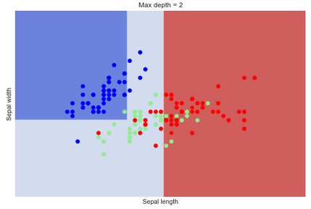
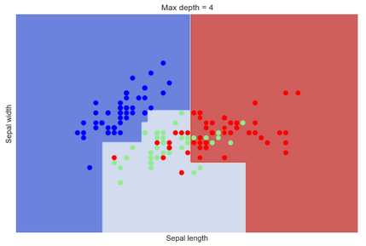
Lab: Visualizing Decision Tree Boundaries (2)
Create a mesh
Create and evaluate predictions for all classifiers
x_min, x_max = X[:, 0].min() - 1, X[:, 0].max() + 1
y_min, y_max = X[:, 1].min() - 1, X[:, 1].max() + 1
xx, yy = np.meshgrid(np.arange(x_min, x_max, h), np.arange(y_min, y_max, h))
for i, classifier in enumerate((depth_2, depth_4)):
plt.figure()
Z = classifier.predict(np.c_[xx.ravel(), yy.ravel()])
Z = Z.reshape(xx.shape)
plt.contourf(xx, yy, Z, cmap = plt.cm.coolwarm, alpha = 0.8)
plt.scatter(X[:, 0], X[:, 1], c = colors, cmap = plt.cm.coolwarm)
plt.xlabel("Sepal length")
plt.ylabel("Sepal width")
plt.xlim(xx.min(), xx.max())
plt.ylim(yy.min(), yy.max())
plt.xticks(())
plt.yticks(())
plt.title(titles[i])
plt.show()

Slide 13
Decision Forests
It's even harder to decide…

Slide 14
Random Forests
Combinations (ensembles) of decision trees
Idea: combine many weak learners (slightly better than random)
Draw a bootstrap sample (random with replacement) of size n
Grow k decision trees on the bootstrap sample
At each node, randomly select d features and split based on max IG
Aggregate the prediction by majority vote
Differences with decision trees
Forests use a random subset of features (trees use all features)
A little harder to interpret than decision trees :(
Advantages :)))
Better (lower) generalization error
Less susceptible to overfitting
Less hyperparameter tuning (in practice, we usually care about k only)

Slide 15
Lab: Random Forests
Create a random forest on the income dataset
Separate data into training and testing set
Fine-tune max_depth, n_estimators (and criterion if you wish)
On the training set
Display a confusion matrix of the best estimator
On the testing set
from sklearn.ensemble import RandomForestClassifier
from sklearn.model_selection import GridSearchCV
from sklearn.metrics import confusion_matrix
params = {"criterion": ["gini", "entropy"], "n_estimators": [2, 5, 10, 25], "max_depth": [None, 2, 3, 5]}
search = GridSearchCV(forest, params)
search.fit(features_train, labels_train)
predicted = search.best_estimator_.predict(features_test)
confusion_matrix(labels_test, predicted)

Slide 16
AdaBoost
Short for "Adaptive Boosting"
Another method to combine weak learners into a string one
Algorithm
Train a weak learner on a random subset (without replacement) of the test data
Draw another random subset and add 50% of the previously misclassified samples; train another weak learner on that
Find the training samples on which both learners disagree to train a third weak learner
Combine the three weak learners via majority voting
Those algorithms tend to overfit the data
We have to check variance carefully

Slide 17
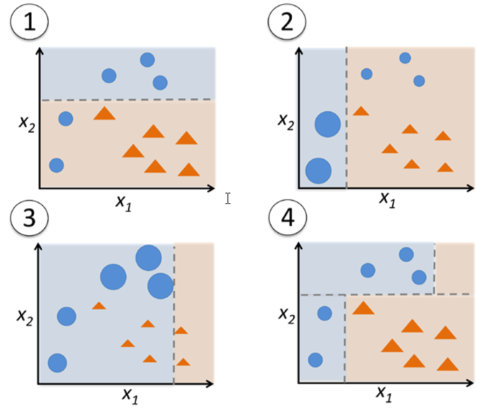
AdaBoost (2)
All samples have equal weight; first classifier: dashed line minimizes an error function
Assign larger weights to misclassified samples, lower weights to correctly classified samples => second classifier "focuses" on misclassified samples
The same as step 2 (we can perform more than two rounds of boosting)
End result: combination of all weak learners (majority vote)

Slide 18
Lab: AdaBoost
Use an AdaBoost classifier to combine 500 "decision stumps" (i.e. decision trees with depth 1)
Use a dataset of your choice (e.g. adult income dataset)
Compare the results to only one tree
from sklearn.metrics import accuracy_score
tree = DecisionTreeClassifier(max_depth = 1)
# Single tree
tree.fit(features_train, labels_train)
train_pred = accuracy_score(labels_train, tree.predict(features_train))
test_pred = accuracy_score(labels_test, tree.predict(features_test))
print( "Decision tree train/test accuracies: %.3f/%.3f",
(train_pred, test_pred))

Slide 19
Lab: AdaBoost (2)
from sklearn.ensemble import AdaBoostClassifier
# Boosted tree
tree = DecisionTreeClassifier(max_depth = 1)
ada = AdaBoostClassifier(base_estimator = tree, n_estimators = 100, learning_rate = 0.1)
ada.fit(features_train, labels_train)
train_pred = accuracy_score(labels_train, ada.predict(features_train))
test_pred = accuracy_score(labels_test, ada.predict(features_test))
print( "AdaBoost tree train/test accuracies: %.3f/%.3f",
(train_pred, test_pred))
Results
AdaBoost is better in most cases – predicts the test and train data better
AdaBoost has higher variance and reduced bias
Better comparison: cross validation; model selection process (CV + "hold-out" set)

Slide 20
Support Vector Machines
A simple idea + a clever trick

Slide 21
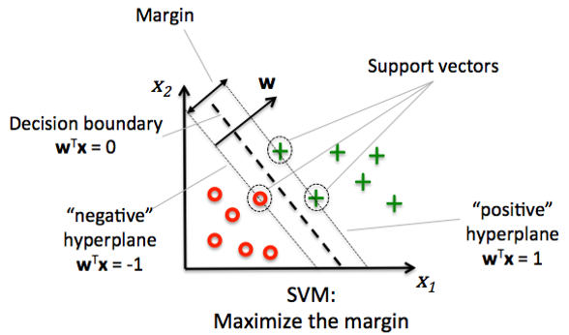
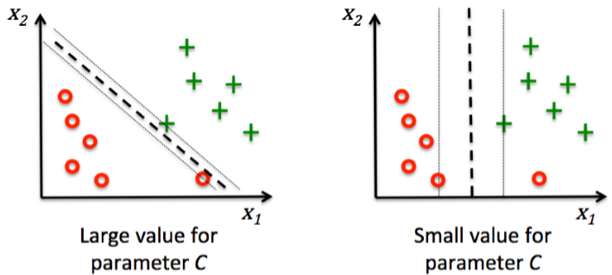
Support Vector Machines
An "ideal" dataset will have very well separated classes
Decision boundary: a simple line
Hyperplane (linear surface) in multiple-dimensional datasets
Goal: maximize the margin (distance from the line to the nearest points – support vectors)
Difficult to separate classes => use regularization
C – penalty for misclassification
Smaller => less strict
Usage: mainly for classification
Regression: rarely

Slide 22
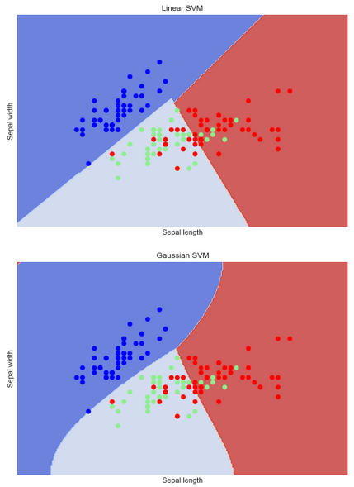
Lab: Support Vector Machines
Use an SVM to predict Iris classes
* Try to fine-tune the parameter C
Print out-of-sample test scores for the model
Plot the decision regions
* Plot a ROC curve
With SVMs, it's very important to scale the data
Mainly for numerical stabilization
from sklearn.svm import SVC
iris_data_std = iris.data
iris_data_std = (iris_data_std - iris_data_std.mean()) / \
iris_data_std.max() - iris_data_std.min()
# TODO: Test / train split
svm = SVC(kernel = "linear", C = 1)
svm.fit(features_train, labels_train)
svm.score(features_test, labels_test)

Slide 23
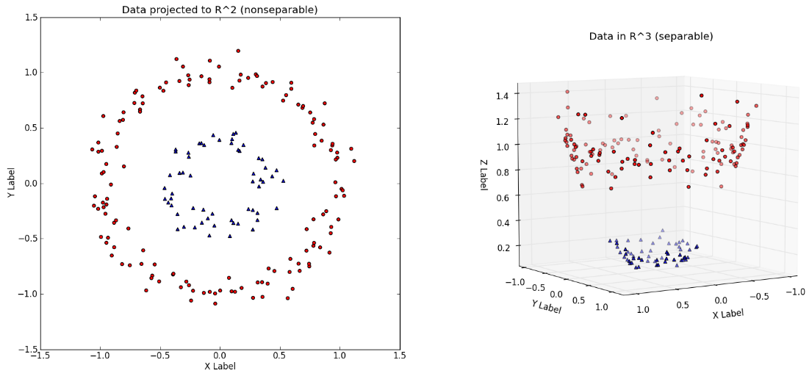
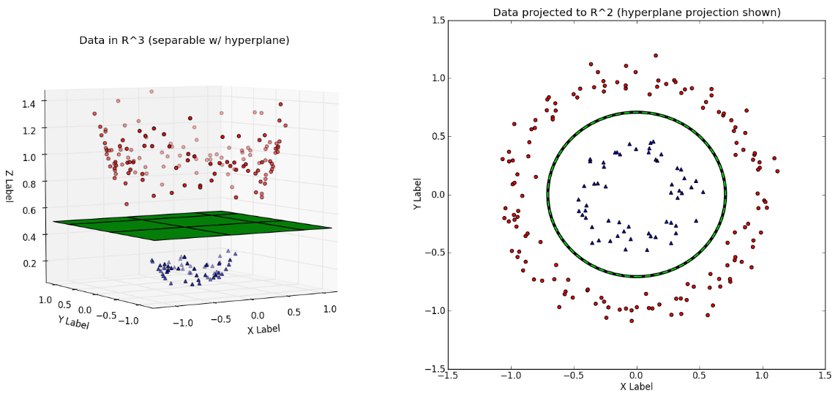
"Kernel Trick"
Used when data is not linearly separable
Algorithm
Create non-linear combinations of the features using a mapping function
This projects them to a higher-dimensional space
The features are now linearly separable => usual SVM separation
Most widely used: Radial Basis Function (Gaussian) kernel
Free parameter – needs to be optimized (e.g. via grid search)

Slide 24
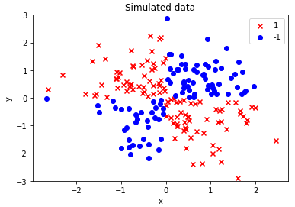
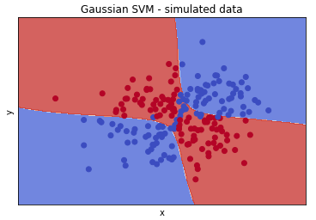
* Lab: Kernel SVM on Simulated Data
Simulate XOR data
Create a Gaussian SVM (C = 10, gamma = 0.1)
* Optimize the parameters
Plot the decision regions
X_xor = np.random.randn(200, 2)
y_xor = np.logical_xor(X_xor[:, 0] > 0, X_xor[:, 1] > 0)
y_xor = np.where(y_xor, 1, -1)
plt.scatter(X_xor[y_xor == 1, 0], X_xor[y_xor == 1, 1], c = "r", marker = "x", label = "1")
plt.scatter(X_xor[y_xor == -1, 0], X_xor[y_xor == -1, 1], c = "b", marker = "s", label = "-1")
plt.ylim([-3, 3])
plt.legend()
plt.show()
svm = SVC(kernel = "rbf", C = 10, gamma = 0.1)

Slide 25
Lab: Kernel SVM on Real Data
Use a Gaussian SVM to predict Iris classes
* Try to fine-tune the parameters
Print out-of-sample test scores for the model
Plot the decision regions
* Plot a ROC curve
* Perform model selection: linear vs. RBF
svm = SVC(kernel = "rbf", C = 1)

Slide 26
k-Nearest Neighbors
"Lazy learning"

Slide 27
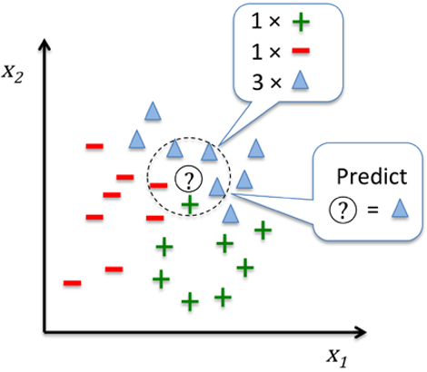
k-Nearest Neighbors (kNN)
"Lazy learner"
Doesn't learn a fitting function but memorizes the training data
Algorithm
Choose a number k and a distance metric (e.g. Euclidean)
This choice provides bias / variance balance
Minkowski distance: generalized Eucledian distance
Find the k nearest neighbors of the current sample
Use majority vote to classify
Advantage: easily adapts to new data
Downside: computational complexity grows linearly with new samples
Efficient implementation: "k-d trees"

Slide 28
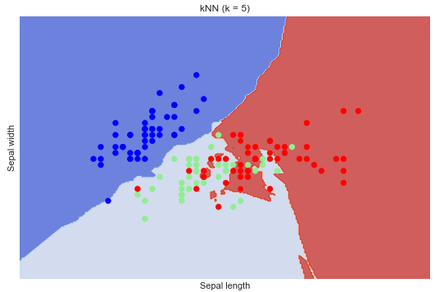
Lab: k-Nearest Neighbors
Perform kNN on iris data
Display the decision regions
from sklearn.neighbors import KNeighborsClassifier
knn = KNeighborsClassifier(n_neighbors = 5)
knn.fit(iris.data, iris.target)

Slide 29
* Lab: Comparison of Classifiers
Select a dataset of your choice
Fine-tune and compare different algorithms
e.g. logistic regression, decision tree, random forest, boosted forest, SVM, kNN
Fine-tune using grid search
Compare using cross-validation and "hold-out" testing
Select the best algorithm
Print and display appropriate metrics
E.g. accuracy, precision and recall; confusion matrix; ROC
If needed, perform dimensionality reduction
E.g. using PCA

Slide 30
Summary
Decision trees
Ensemble algorithms
Random decision forests
AdaBoost
Support vector machines (SVMs)
k-nearest neighbors

